Slide 1



TASK MANAGEMENT SYSTEM
BY
202322240338
202322240303
202322240316

Slide 2

WELCOME TO
OUR PRESENTATION
The aim of this project is to create a user-friendly task management system to manage users, tasks, comments, notifications, and attachments effectively.

Slide 3

FEATURES
USER MANAGEMENT.
TASK TRACKING WITH PRIORITY AND STATUS
COMMENTING SYSTEM FOR COLLABORATION.
NOTIFICATIONS FOR TASK UPDATES.
FILE ATTACHMENTS FOR TASKS

Slide 4

SYSTEM ARCHITECTURE
BaseEntity
├── User
├── Task
├── Comment
├── Notification
└── Attachment
TaskManager
├── Manages 1..* User
├── Manages 1..* Task
├── Manages 1..* Comment
├── Manages 1..* Notification
└── Manages 1..* Attachment
Main
└── Uses TaskManager
In this structure:
BaseEntity is an abstract class that provides a common id field for all entities.
The TaskManager class acts as the central controller, managing collections of the primary entities (User, Task, Comment, Notification, and Attachment).
Main initializes and interacts with the TaskManager
to perform operations.

Slide 5
CODE EXPLANATION
Components
Key Classes:
BaseEntity: Abstract class to provide a common id field for all entities.
User: Manages user-related attributes and operations.
Task: Represents tasks with attributes like title, description, priority, and status.
Comment: Allows users to comment on tasks.
Notification: Sends reminders or updates.
TaskManager:
Centralized class for CRUD operations.
Handles data persistence using serialization.
Methods include addUser, addTask, addComment, and displayAll.

Slide 6
CODE EXPLANATION
Code Snippets
BaseEntity is the parent class for all entities that require a unique identifier (id). This ensures that every subclass (like User, Task, etc.) will inherit the id field and its getter/setter methods.
Serializable ensures that objects of this class can be saved and loaded from a file using Java's serialization mechanism.
abstract class BaseEntity implements Serializable {
private int id;
public BaseEntity(int id) {
this.id = id;
}
public int getId() {
return id;
}
public void setId(int id) {
this.id = id;
}
}

Slide 7
CODE EXPLANATION
Code Snippets
public void addUser (User user) {
users.add(user);
saveData();
}
addUser(User user): Adds a user to the users list.
saveData(): After adding the user, this method ensures that the data is serialized and stored in the file (task_management_data.dat), so the system retains the user even after restarting.

Slide 8
CODE EXPLANATION
Code Snippets
public void displayAll() {
System.out.println("Users:");
for (User user : users) {
System.out.println("User ID: " + user.getId() + ", Username: " + user.getUsername());
}
System.out.println("\nTasks:");
for (Task task : tasks) {
System.out.println("Task ID: " + task.getId() + ", Title: " + task.getTitle());
}
System.out.println("\nComments:");
for (Comment comment : comments) {
System.out.println("Comment ID: " + comment.getId() + ", Text: " + comment.getCommentText());
}
System.out.println("\nNotifications:");
for (Notification notification : notifications) {
System.out.println("Notification ID: " + notification.getId() + ", Message: " + notification.getMessage());
}
System.out.println("\nAttachments:");
for (Attachment attachment : attachments) {
System.out.println("Attachment ID: " + attachment.getId() + ", File Name: " + attachment.getFileName());
}
}
displayAll(): This method iterates over all the lists (users, tasks, comments, notifications, attachments) and prints out relevant information about each entity, making it easy to view the contents of the system at any time.

Slide 9
CODE EXPLANATION
Code Snippets
private void saveData() {
try (ObjectOutputStream oos = new ObjectOutputStream(new FileOutputStream(filePath))) {
oos.writeObject(users);
oos.writeObject(tasks);
oos.writeObject(comments);
oos.writeObject(notifications);
oos.writeObject(attachments);
} catch (IOException e) {
e.printStackTrace();
}
}
saveData(): This method uses ObjectOutputStream to serialize all the lists into a file at the path filePath (task_management_data.dat). This allows us to save the entire system's state.
catch (IOException e): Catches any I/O errors during the writing process (e.g., file access issues) and prints the stack trace.

Slide 10
CODE EXPLANATION
Code Snippets
@SuppressWarnings("unchecked")
private void loadData() {
try (ObjectInputStream ois = new ObjectInputStream(new FileInputStream(filePath))) {
users = (List<User>) ois.readObject();
tasks = (List<Task>) ois.readObject();
comments = (List<Comment>) ois.readObject();
notifications = (List<Notification>) ois.readObject();
attachments = (List<Attachment>) ois.readObject();
} catch (IOException | ClassNotFoundException e) {
users = new ArrayList<>();
tasks = new ArrayList<>();
comments = new ArrayList<>();
notifications = new ArrayList<>();
attachments = new ArrayList<>();
}
}
loadData(): This method deserializes the data stored in the file (task_management_data.dat) back into the users, tasks, comments, notifications, and attachments lists.
catch (IOException | ClassNotFoundException e): If the file does not exist or the data format is corrupted, it catches the exception and initializes the lists as empty, ensuring the program doesn’t crash.

Slide 11
CODE EXPLANATION
Code Snippets
public class Main {
public static void main(String[] args) {
TaskManager taskManager = new TaskManager();
// Create Users
User user1 = new User(1, "john_doe", "john@example.com", "password123", "Admin");
User user2 = new User(2, "jane_smith", "jane@example.com", "password456", "User");
// Add Users to TaskManager
taskManager.addUser(user1);
taskManager.addUser(user2);
// Create Tasks
Task task1 = new Task(1, "Complete Project", "Finish the project by end of the week", 'H', "john_doe", "In Progress");
Task task2 = new Task(2, "Buy Groceries", "Milk, Bread, Eggs", 'M', "jane_smith", "Pending");
// Add Tasks to TaskManager
taskManager.addTask(task1);
taskManager.addTask(task2);
// Display all data
taskManager.displayAll();
}
}
Main: This is the entry point of our application. It creates an instance of TaskManager and adds users and tasks to it.
The program then calls displayAll() to print all data stored in the system, demonstrating how the system works in action.

Slide 12
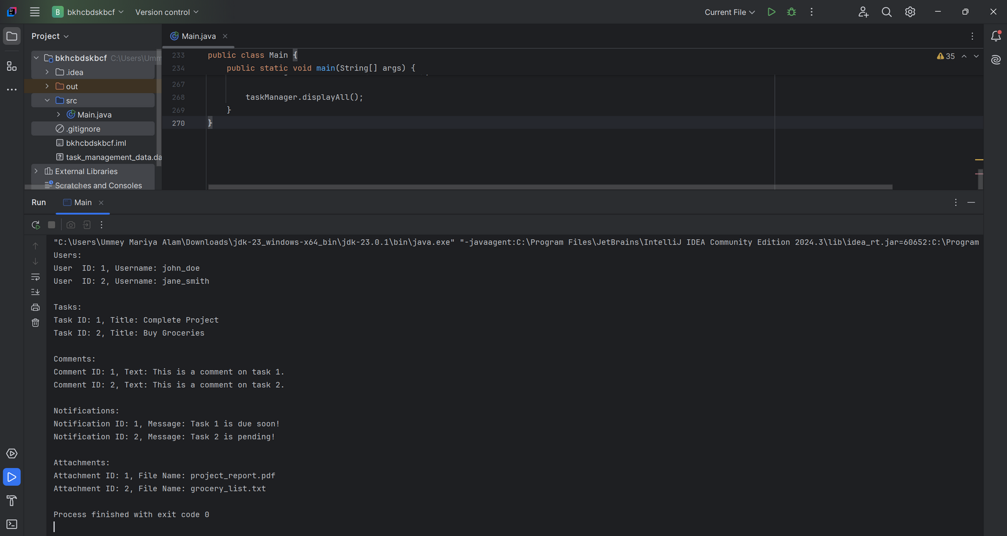
FEATURES DEMONSTRATION

Slide 13
CHALLENGES FACED
CREATING A MODULAR AND SCALABLE CLASS STRUCTURE WAS DIFFICULT, ESPECIALLY WHEN WORKING WITH SEVERAL ENTITIES SUCH AS USER, TASK, AND COMMENT.
ESTABLISHING REFERENCES (SUCH AS IDENTIFYING A TASK WITH A CERTAIN USER OR ATTACHING COMMENTS TO TASKS) RESULT IN MISMATCHES OR ERRONEOUS DATA.
INVALID OR MISSING INFORMATION (FOR EXAMPLE, A USER WITHOUT AN EMAIL OR A TASK WITHOUT A TITLE) RESULTED IN RUNTIME ERRORS OR LOGICAL INCONSISTENCIES.
To maintain relationships between things, we use unique IDs. Adding validation methods to TaskManager to ensure references are correct before saving data.
Before implementing classes, planning their relationships using UML diagrams. Begining with a basic structure and gradually add functionality.
Validating input in setter methods or within the TaskManager class. Used exceptions to appropriately deal with incorrect data inputs.

Slide 14


CONCLUSION
In conclusion, this project represents a robust and modular Task Management System implemented in Java. It demonstrates the application of object-oriented programming principles such as encapsulation, inheritance, and abstraction, creating a well-structured and scalable solution.
The TaskManager class serves as the backbone of the system, efficiently managing users, tasks, comments, notifications, and attachments while ensuring data persistence through file serialization. This design emphasizes maintainability and extensibility, allowing for future enhancements such as integrating a database or developing a graphical user interface.
Through this project, I gained valuable insights into:
Designing and implementing real-world solutions using Java.
Utilizing abstract classes and relationships between entities.
Managing data storage and retrieval effectively.

